Slide 1
Financial Goals
By derlin Castillo

Slide 2
Instructions
Here you are making goals
Think about the future—like when you are 30
Answer the questions
Follow the instructions
Include pictures

Slide 3
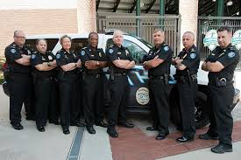
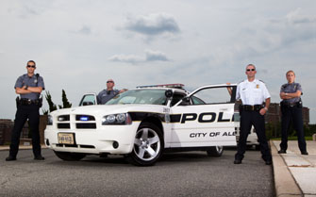
Long-Term Career Goal
What career do you want? Being a Police Officer has always been my dream and goal to reach or achieve.
Why do you want this career? After been living in El Salvador and seen that some cops are corrupt, I created my life goal and that is to become an police officer do the right thing and help anyone in needs no matter what.
How much will you make? According to the statistics of Police officers wages in Alexandria, the salary I could make becoming a Police Officers could be around $40,239 – $58,346 per year.

Slide 4
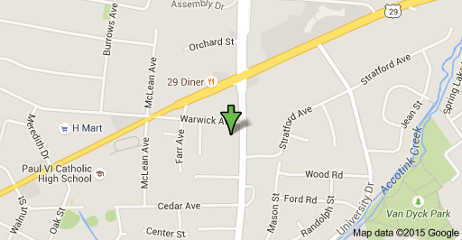
Long-Term House goals
Will you buy a house? Rent? I have thought about that and I think that first I will rent an apartment while I get enough credit I will get a house.
Where will you live? Anywhere I have to… depending on my job.
Look up an address on the internet… how much will it cost? $769,000
Estimated Mortgage = $2,895/mo
How much per month do you think you’ll spend? $4,950 - $6,000

Slide 5
Long-Term Goal #3
What else is important to you? Have a second profession as an alternative option
Why? Because whether there is not work for me as a police, there should be work as a teacher. (ELL English teacher)
How much will it cost? Adding the cost of my studies as a police officer and as a teacher the cost would be around $80,000 – $100,000

Slide 6
Long-Term Goal #4
What else is important to you? Something important to me as a future ELL English teacher is to come with a better and faster way to teach those students that just came to the country.
Why? This is important to me because when I just came here I did not know any English. I was struggling a lot with my learning because teachers were not teaching me the basics and I think that to teach a different language to someone new means starting from zero.
How much will it cost? The cost of this will not be money, instead it will be effort and experience coming from me.
Some Teachers Be Like…

Slide 7
Long-Term Goal #5
What else is important to you? Becoming a police officer and then move forward to a higher position is other goal I must reach in life.
Why? This is important to me because beside I will be proud of myself, I want my family to be proud too and see how badly I want to succeed in life and give them back everything they have gave me. Also I want to get/earn an important position as a police officer to have right and change those abuses that today is happening in some states that people thinks that it is a cause by racial profile something that should be gone by this new generation.

Slide 8
Summary of Long Term Goals
How much do you plan on earning? At least $40,000 - $60,000 per year
How long will it take? Depends on the level of diploma I will get
How much do you plan on spending? As much as needed

Slide 9
How do I accomplish my Long-Term goals?
I believe that accomplishing long-term goals means just to work a little bit harder, always trying your harder, and believing in yourself. I believe that setting a goal and out your sight directly into it can help anyone to accomplish is goals no matter how harder it is or how many obstacles could be faced in the way of achieving it.

