Slide 1
WISE Buyer versus Conspicuous Consumer

Slide 2
Conspicuous Buy: Ipad Air
Apple iPad Air 2 (64GB)
Price: $554
Why is it conspicuous?
The Ipad is the most wanted tablet in the market
Why is it expensive?
This Ipad has 64gb and is the newest model

Slide 3
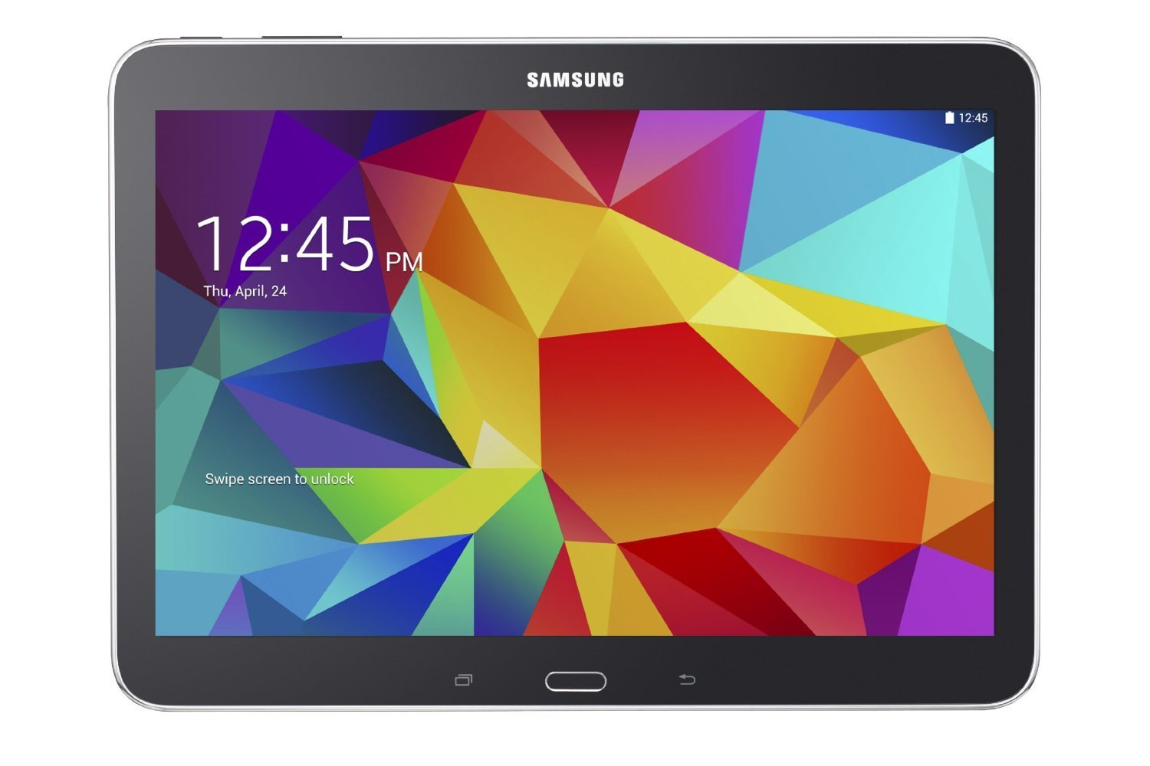
Wise Buy: Samsung Galaxy
Samsung Galaxy Tab 16gb
Price: $244.99
Why is it WISE?
This tablet is cheaper but has similar functions
I sacrifice GB space but I don’t need them

Slide 4
Conspicuous Buy: Jordan Air Jordan 6 Retro blue
Jordan Retro 6 blue
Price: $500.00
Why is it conspicuous?
The Jordan Retro is the most wanted shoes in the market
Why is it expensive?
This shoes are unique because the company just make some of these shoes and boys have to be faster to get because everyone wish to get it.

Slide 5
Wise Buy :Vans Unisex Authentic Sneaker
Vans Unisex Sneaker
Price: $30.00
Why is it wise?
It is wise because it is no fancy any more and some stores want to sales in any price
Why is it cheap?
It is cheap because materials are bad

Slide 6
Conspicuous Buy :Beats Wireless On-Ear Headphone - Black
Beats wireless (64GB)
Price: $260.00
Why is it conspicuous?
Incredibly clear sound. Beats Wireless headphones feature powerful sound, as clear and strong as any wired headphone. They also come with a cable you can plug into if you don't want to go wireless.
Why is it expensive?
Stream audio from your laptop, or any other Bluetooth-enabled device, even TV's, from up to 30 feet away. Beats Wireless headphones support SBC, APT-X and AAC Bluetooth, which means you'll always have a high-quality stream.

Slide 7
Sentey ® Headphone Headset
Price: $16.99
Why is it wise?
It is cheap because it is no fancy any more and some stores want to sales in any price
Why is it cheap?
It is cheap because materials are bad and the model look ugly

Slide 8
Conspicuous Buy :Samsung UN105S9 Curved 105-Inch 4K Ultra HD 120Hz 3D Smart LED TV
Apple Samsung smart LEDTV
Price: $119,999.99
Why is it conspicuous?
Refresh Rate: 120Hz (Native); 1440 Clear Motion Rate (Effective) Backlight: LED Smart Functionality: Yes - Voice and Motion Control (camera accessory sold separately) Dimensions (W x H x D): TV without stand: 96.5" x 42.5" x 11.5"; TV with stand: 98.1" x 57.5" x 24.6" Inputs: 4 HDMI 2.0, 4 USB, 1 Ethernet, 1 Component In, 2 Composite AV In
Why is it expensive?
It was made it with good materials and also has 3D active glasses.

Slide 9
Wise Buy: Element ELEFW195 19-Inch 720p 60hz LED TV
Price: $79.99
Why is it wise?
It is wise because it was a fancy TV but now there are new better branches
Why is it cheap?
It is cheap because materials are bad and the model is old and does have especial items

Slide 10
Conspicuous Buy : Gucci watches for men - Pantheon Silver-Tone Steel Black Dial with diamonds
Gucci watch
Price: $1,599.00
Why is it conspicuous?
This watch is best watch in the top model
Why is it expensive?
It is expensive because has diamonds and it is a Gucci mark that is a famous mark.

Slide 11
Wise Buy: HACBIWA Classic Golden Bracelet Men Stainless Steal Wrist Watch
HACBIWA watch
Price: $6.29
Why is it wise?
It is wise because no body want and stores has to sales it very cheap
Why is it cheap?
It is cheap because materials are bad

Slide 12
Conspicuous Buy : Dumas Station WS 91+ points Cabernet Sauvignon Vintage Vertical (2006 & 2008)
Dumas Station wine
Price: $136.00
Why is it conspicuous?
This wine is one of the most delicious wine from Dayton, WA
Why is it expensive?
It is expensive because was made in 2006 and has 9 years old so this mean this wine has a good flavor

Slide 13
Wise Buy: 2012 Gaucho Andino Carmenere
Guacho Andino Carmenere wine
Price: $3.99
Why is it wise?
It is wise because the flavor is bad
Why is it cheap?
It is cheap because it was made in 2012, so it only has 3 years old

Slide 14
Conspicuous Buy : Mega Power™ Exhaust System
Exhaust system
Price: $520.97
Why is it conspicuous?
This exhaust system is conspicuous because add 40 power horses to your vehicle
Why is it expensive?
It is expensive because it has all parts I mean it is the full system

Slide 15
Wise Buy :Titanium Burnt Tip Exhaust Cat back System
Exhaust system
Price: $119.97
Why is it wise?
This exhaust system is wise because this brand is not fancy and the song that it make is terrible
Why is it cheap?
It is cheap because it has cheap materials

Slide 16
Conspicuous Buy :Series Typhoon Cold Air Intake Kit
Air intake system
Price: $262.99
Why is it conspicuous?
This air intake system is conspicuous because it add more horsepower than others brand
Why is it expensive?
It is expensive because it is made with titanium so the main million mile limited warranty

Slide 17
Wise Buy :Aluminum Short Ram Air Intake System (Blue)
Air intake system
Price: $262.99
Why is it wise?
This air intake system is wise because it is a short system and it can not work very well
Why is it cheap?
It is cheap because it is made with aluminum so the main just work by thousand of mile limited warranty

Slide 18
Conspicuous Buy : Amazon Echo
Speaker Echo
Price: $179.99
Why is it conspicuous?
This speaker is conspicuous because it has all new apps and the Bluetooth can be get it by 25 meters
Why is it expensive?
It is expensive because amazon made it with capacity of never diet.

Slide 19
Wise Buy :Bluetooth Speaker, TaoTronics Portable Bluetooth Wireless Speaker
Bluetooth speaker
Price: $25.00
Why is it wise?
This speaker is wise because it is has a lower Bluetooth connection
Why is it cheap?
It is cheap because it is made with bad materials and does not have good song

Slide 20
Conspicuous Buy :Apple iPhone 6 64GB
IPhone 6 (64GB)
Price: $823.10
Why is it conspicuous?
This iPhone is conspicuous because it is the new iPhone and everyone want it
Why is it expensive?
It is expensive because it all apps than others phones

Slide 21
Wise Buy : Apple iPhone 4
iPhone 4
Price: $125.00
Why is it wise?
This iPhone is wise because it is too old
Why is it cheap?
It is cheap because there are new brand better than this

